Slide 2
As you come to him, the living Stone - rejected by humans but chosen by God and precious to [God] - you also, like living stones, are being built into a spiritual house to be a holy priesthood, offering spiritual sacrifices acceptable to God through Jesus Christ. For in Scripture it says:
“See, I lay a stone in Zion,
a chosen and precious cornerstone,
and the one who trusts in him
will never be put to shame.”
1 Peter 2:4-6, NIV

Slide 3
WELCOME
&
INVITATION
*In the following five weeks of worship, you are invited to find a stone you can hold, to be included as part of your worship.*
As you come to him, the living stone - rejected by humans but chosen by God and precious to God…
We, like living stones, are being built into a spiritual house to be a holy priesthood.

Slide 4
WELCOME
&
INVITATION
As you reflect upon your journey of faith thus far and perhaps the path that is before you, think about the obstacles, rocky or uneven terrain that have caused you to stumble - either as an individual or as a community of faith.
*While holding your stone, consider what has caused you and/or your community to stumble as you walk along your journey with the Risen Christ.*

Slide 5
CALL TO WORSHIP
Friends, the Risen Lord is among us and walks with us on our journey.
Open our eyes that we might recognize him and follow him.
God may come to us, unrecognized, as a stranger as we travel our own Emmaus roads.
May the words of the Risen Christ burn in our hearts as we continue on our journey.
Open your eyes this day to see the goodness of the Lord.
Open our hearts, gracious God, to receive your blessings.

Slide 6
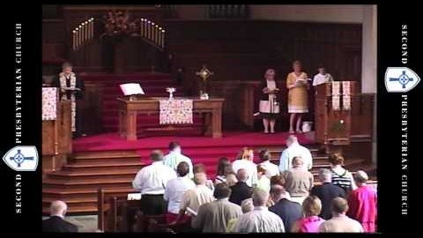
IN CHRIST THERE IS NO EAST OR WEST
Glory to God #317

Slide 7
CALL TO CONFESSION
We confess together as a community of faith because we acknowledge the reality of sin in the church, the world, and our personal lives, and so we ask God for forgiveness and help in amending our lives. And the proof of God’s amazing love is this: while we were sinners Christ died for us. Because we have faith in him, we dare to approach God with confidence, assured of a forgiveness already given through Christ.

Slide 8
PRAYER OF CONFESSION
Good and gracious God, we are creatures of dust, ignorant of your revelation, misunderstanding of your life, death, and resurrection among us, needing forgiveness. We repent of our failure to give as you have given to us. We beg your mercy for our fallen world. We seek your Word, that we may live with the faith of Jesus. Be our solace in this life and always.

Slide 9
PRAYER OF CONFESSION
We ask this as your own children, holy and incomplete. Forgive us and lead us. Amen.
*Find a place and lay down your stone, your stumbling blocks, into God’s keeping now.*
Liturgy provided from Feasting on the Word Worship Companion - Reprinted by permission of Westminster John Knox Press from Feasting on the Word: Liturgies for Year A, Volume 1. Copyright 2013.

Slide 10
ASSURANCE OF PARDON
Friends, hear the good news! Who is in a position to condemn? Only Christ, and Christ died for us, Christ rose for us, Christ reigns in power for us, Christ prays for us. Anyone who is in Christ is a new creation. The old life has gone; a new life has begun. Know that we are forgiven and be at peace.
Amen.

Slide 11
PRAYER FOR ILLUMINATION
Holy God, by your Spirit reveal your radical, surprising love; come to us through your holy word, and let us hear what you are saying. Amen.
Liturgy provided from Feasting on the Word Worship Companion - Reprinted by permission of Westminster John Knox Press from Feasting on the Word: Liturgies for Year A, Volume 1. Copyright 2013.

Slide 12
SCRIPTURE
Luke 24:13-35
Now on that same day two of them were going to a village called Emmaus, about seven miles from Jerusalem, and talking with each other about all these things that had happened. While they were talking and discussing, Jesus himself came near and went with them, but their eyes were kept from recognizing him. And he said to them, ‘What are you discussing with each other while you walk along?’ They stood still, looking sad.

Slide 13
SCRIPTURE
Luke 24:13-35
Then one of them, whose name was Cleopas, answered him, ‘Are you the only stranger in Jerusalem who does not know the things that have taken place there in these days?’ He asked them, ‘What things?’ They replied, ‘The things about Jesus of Nazareth, who was a prophet mighty in deed and word before God and all the people, and how our chief priests and leaders handed him over to be condemned to death and crucified him.

Slide 14
SCRIPTURE
Luke 24:13-35
But we had hoped that he was the one to redeem Israel. Yes, and besides all this, it is now the third day since these things took place. Moreover, some women of our group astounded us. They were at the tomb early this morning, and when they did not find his body there, they came back and told us that they had indeed seen a vision of angels who said that he was alive. Some of those who were with us went to the tomb and found it just as the women had said; but they did not see him.’

Slide 15
SCRIPTURE
Luke 24:13-35
Then he said to them, ‘Oh, how foolish you are, and how slow of heart to believe all that the prophets have declared! Was it not necessary that the Messiah should suffer these things and then enter into his glory?’ Then beginning with Moses and all the prophets, he interpreted to them the things about himself in all the scriptures.

Slide 16
SCRIPTURE
Luke 24:13-35
As they came near the village to which they were going, he walked ahead as if he were going on. But they urged him strongly, saying, ‘Stay with us, because it is almost evening and the day is now nearly over.’ So he went in to stay with them. When he was at the table with them, he took bread, blessed and broke it, and gave it to them. Then their eyes were opened, and they recognized him; and he vanished from their sight.

Slide 17
SCRIPTURE
Luke 24:13-35
They said to each other, ‘Were not our hearts burning within us while he was talking to us on the road, while he was opening the scriptures to us?’ That same hour they got up and returned to Jerusalem; and they found the eleven and their companions gathered together. They were saying, ‘The Lord has risen indeed, and he has appeared to Simon!’ Then they told what had happened on the road, and how he had been made known to them in the breaking of the bread.

Slide 18
MESSAGE

Slide 19
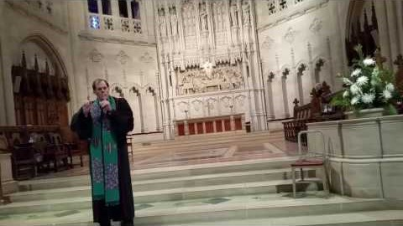
DAY OF ARISING
Glory to God #252

Slide 20
PRAYERS OF THE PEOPLE
God who led the Israelites by day and by night, in cloud and in fire, we find ourselves stumbling like they did. We are afraid of change so we point fingers, we complain that things aren’t like they used to be, we dig our heels in, we promise we are going back from where we came. Help us to remember that even though the circumstances of the Israelites changed, you did not. You remained in relationship with them as you do with us, into every new place and time. Open our eyes and our hearts

Slide 21
PRAYERS OF THE PEOPLE
that we might follow your lead for you have already been where we are going and you do not leave us to walk alone.
God of our hearts, you made us to be healthiest when in community and we have found ourselves unthinkably separated. Strengthen us for these times apart. Guide us into new ways of connection and open our hearts that we might welcome them even as we sincerely grieve the ways that were.

Slide 22
PRAYERS OF THE PEOPLE
God who was and is and will be, be with us as we process what has been, what is, and what is to come, for it all seems too much. Send your Spirit of grace upon us that we might find grace for ourselves and for others in these overwhelming times, we pray. We ask all of these things through Christ, who taught us to pray, saying:

Slide 23
THE LORD’S PRAYER
Our Father, who art in heaven, hallowed be thy name.
Thy kingdom come, thy will be done, on earth as it is in heaven.
Give us this day our daily bread;
and forgive us our debts, as we forgive our debtors;
and lead us not into temptation, but deliver us from evil.
For thine is the kingdom and the power and the glory, forever. Amen.

Slide 24
OFFERING
Sometimes the rocks on the road of Christian discipleship cause us to stumble. We trip over bad habits and stub our toes on practices that seem perfectly sensible from the world’s perspective, but that keep us from recognizing our Lord who walks beside us. Spiritual practices like prayer and reading the Bible and charitable giving help us to avoid the rocks in the road. Your offering will allow us all to keep our eyes fixed on Jesus that we might walk with him without stumbling. Please consider giving online or by check this week.

Slide 25
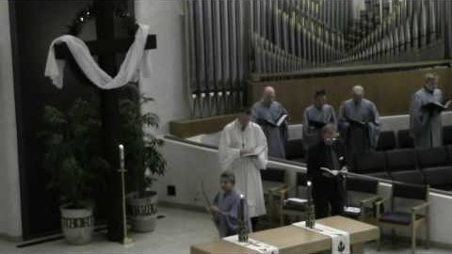
CHRIST IS RISEN! SHOUT HOSANNA!
Glory to God #248

Slide 26
CHARGE & BENEDICTION
The road to Emmaus awaits us all. You will not walk this journey alone for we take our community with us wherever we are. May the road before you be smooth, not rocky; may it be level, not steep; may it provide adventure, but not danger. And, with eyes open in wonder, may you encounter the Risen Christ in your midst.

