Slide 2
You are coming to Christ, who is the living cornerstone of God’s temple. He was rejected by people, but he was chosen by God for great honor.
And you are living stones that God is building into his spiritual temple. What’s more, you are his holy priests. Through the mediation of Jesus Christ, you offer spiritual sacrifices that please God. As the Scriptures say,
“I am placing a cornerstone in Jerusalem,
chosen for great honor,
and anyone who trusts in him
will never be disgraced.”
1 Peter 2:4-6, NLT

Slide 3
WELCOME
&
INVITATION
You are coming to Christ, who is the living cornerstone of God’s temple. He was rejected by people, but he was chosen by God for great honor.
And we are living stones that God is building into a spiritual temple. What’s more, we are God’s holy priests. Through the mediation of Jesus Christ, we offer spiritual sacrifices that please God.

Slide 4
WELCOME
&
INVITATION
If you’ve been with us the last four weeks, you may have noticed that there are no stones for our beginning time of reflection! God is everywhere and can not be contained! God is limitless and is not confined in our church walls or built into a shrine or shaped by our human minds. God dwells in and among all peoples and places and lovingly embraces all of creation!

Slide 5
CALL TO WORSHIP
FINDING GOD
We worship the God who inhabits our world
and indwells our lives.
We need not look up to find God,
we need only to look around:
within ourselves,
beyond ourselves,
into the eyes of another.
We need not listen for a distant thunder to find God,

Slide 6
CALL TO WORSHIP
we need only listen to the music of life,
the words of children,
the questions of the curious,
the rhythm of a heartbeat.
We worship the God who inhabits our world
and who indwells our lives.
Finding God: posted on the Presbyterian Church USA website; https://www.pcusa.org/site_media/media/uploads/peacemaking/pdf/mlk-resources.pdf

Slide 7
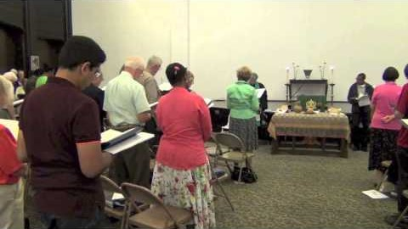
GOD, YOU SPIN THE WHIRLING PLANETS
Glory to God #23

Slide 8
CALL TO CONFESSION
We confess together as a community of faith because we acknowledge the reality of sin in the church, the world, and our personal lives, and so we ask God for forgiveness and help in amending our lives. And the proof of God’s amazing love is this: while we were sinners Christ died for us. Because we have faith in him, we dare to approach God with confidence, assured of a forgiveness already given through Christ.

Slide 9
PRAYER OF CONFESSION
Loving God, we have not loved you or each other with our whole hearts. Forgive us, we pray, and lead us toward wholeness, that we may be filled with your joy. In Jesus’ name we pray. Amen.
Liturgy provided from Feasting on the Word Worship Companion - Reprinted by permission of Westminster John Knox Press from Feasting on the Word: Liturgies for Year A, Volume 1. Copyright 2013.

Slide 10
ASSURANCE OF PARDON
Friends, hear the good news! Who is in a position to condemn? Only Christ, and Christ died for us, Christ rose for us, Christ reigns in power for us, Christ prays for us. Anyone who is in Christ is a new creation. The old life has gone; a new life has begun. Know that we are forgiven and be at peace.
Amen.

Slide 11
PRAYER FOR ILLUMINATION
Pour out your Holy Spirit upon us, O God, in the reading of your Word, that we would hear what you have to say to us today. May your Holy Spirit be poured out upon us; through Jesus Christ. Amen.
Liturgy provided from Feasting on the Word Worship Companion - Reprinted by permission of Westminster John Knox Press from Feasting on the Word: Liturgies for Year A, Volume 1. Copyright 2013.

Slide 12
SCRIPTURE
Acts 17:22-31
Then Paul stood in front of the Areopagus and said, ‘Athenians, I see how extremely religious you are in every way. For as I went through the city and looked carefully at the objects of your worship, I found among them an altar with the inscription, “To an unknown god.” What therefore you worship as unknown, this I proclaim to you. The God who made the world and everything in it, he who is Lord of heaven and earth, does not live in shrines made by human hands, nor is he served by human hands,

Slide 13
SCRIPTURE
Acts 17:22-31
as though he needed anything, since he himself gives to all mortals life and breath and all things. From one ancestor he made all nations to inhabit the whole earth, and he allotted the times of their existence and the boundaries of the places where they would live, so that they would search for God and perhaps grope for him and find him—though indeed he is not far from each one of us. For “In him we live and move and have our being”; as even some of your own poets have said,

Slide 14
SCRIPTURE
Acts 17:22-31
“For we too are his offspring.”
Since we are God’s offspring, we ought not to think that the deity is like gold, or silver, or stone, an image formed by the art and imagination of mortals. While God has overlooked the times of human ignorance, now he commands all people everywhere to repent, because he has fixed a day on which he will have the world judged in righteousness by a man whom he has appointed, and of this he has given assurance to all by raising him from the dead.’

Slide 15
MESSAGE

Slide 16
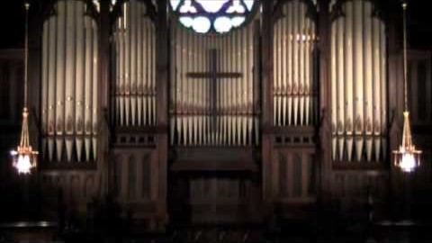
GOD OF OUR LIFE
Glory to God #686

Slide 17
PRAYERS OF THE PEOPLE
God beyond our comprehension, we have put you in our neat little containers because we find you easiest to understand that way, not because you are that way. We have made you tiny, fitting neatly in a book, or on a cross around our necks or tattooed on our arms, or even into a sanctuary. Like the blossoms which are bursting forth, propel our understandings out of those small, confining places that we might find a glimpse of your expansiveness, your expansive care, your expansive love in its full glory. We pray for that same expansiveness to burst

Slide 18
PRAYERS OF THE PEOPLE
from us, unlocking our tight ways and providing us a freedom which comes from the abundance you offer. Open our hands that we might risk offering abundance from our material goods; open our hearts that we might risk offering abundance in love; open our mouths that we might risk offering abundance of grace. In so doing, might we also know abundant life, we pray.
God beyond our walls, what mighty things you have done in this world, across generations, and through your people. We give you thanks for the myriad

Slide 19
PRAYERS OF THE PEOPLE
good things that have happened in trying times. We give you thanks for the people who have been part of bringing good and we thank you for the ways your Spirit has nudged us to be bringers of good. When we fatigue and grow weary, send us strength for the work to be done, we pray. When we feel overwhelmed, send us partners in the creation of kindness. When we doubt, send us affirmations that the good we do matters. We ask all of these things through Christ, who taught us to pray, saying:

Slide 20
THE LORD’S PRAYER
Our Father, who art in heaven, hallowed be thy name.
Thy kingdom come, thy will be done, on earth as it is in heaven.
Give us this day our daily bread;
and forgive us our debts, as we forgive our debtors;
and lead us not into temptation, but deliver us from evil.
For thine is the kingdom and the power and the glory, forever. Amen.

Slide 21
OFFERING
God has marked the work of the church by time and boundaries. We will not be here forever, nor does God intend that. We can, however, be part of God’s mission in the world right now. Through your gifts, we can actively join in what God is doing in our community and around the world. Please consider giving online or by check this week.

Slide 22

THE CHURCH OF CHRIST CANNOT BE BOUND
Glory to God #766

Slide 23
CHARGE & BENEDICTION
The walls of the church are solid; they have withstood storms from without and remodeling from within. But, these walls will not stand forever, for God has marked our time and boundaries. For the time allotted to us then, let us not be the church behind the walls, but the church beyond the walls. May the Triune God - three in one - bless you and keep you from this day forward.

