Slide 2
Welcome to the living Stone, the source of life. The [workers] took one look and threw it out; God set it in the place of honor. Present yourselves as building stones for the construction of a sanctuary vibrant with life, in which you’ll serve as holy priests offering Christ-approved lives up to God. The Scriptures provide precedent:
Look! I’m setting a stone in Zion,
a cornerstone in the place of honor.
Whoever trusts in this stone as a foundation
will never have cause to regret it.
1 Peter 2:4-6, The Message

Slide 3
WELCOME
&
INVITATION
Welcome to the living Stone, the source of life. The workers took one look and threw it out; God set it in the place of honor.
We present ourselves as building stones for the construction of a sanctuary vibrant with life, in which we will serve as holy priests offering Christ-approved lives up to God.

Slide 4
CALL TO WORSHIP
Come to him, a living stone, though rejected by mortals yet chosen and precious in God’s sight.
Let us, like living stones, be built into a spiritual temple; a holy priesthood.
We came with doubts…
but the millstone has been lifted.
We stumbled unseeing on our journey with Christ,
but now our footsteps are sure.
Like thieves we scaled a rock wall,
Seeking to find security.

Slide 5
CALL TO WORSHIP
God’s house has many rooms.
We are ready to encounter God in unlikely places.
God is not limited to one place or one time.
We will serve beyond these walls to where God calls us.
You are called to be living stones, in this congregation and out in the world.
We are living stones, we are a spiritual house, we are a holy priesthood!

Slide 6
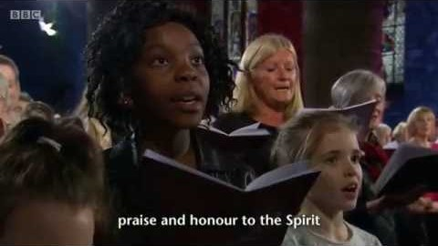
CHRIST IS MADE THE SURE FOUNDATION
Glory to God #394

Slide 7
CALL TO CONFESSION
We confess together as a community of faith because we acknowledge the reality of sin in the church, the world, and our personal lives, and so we ask God for forgiveness and help in amending our lives. And the proof of God’s amazing love is this: while we were sinners Christ died for us. Because we have faith in him, we dare to approach God with confidence, assured of a forgiveness already given through Christ.

Slide 8
PRAYER OF CONFESSION
God, though you call us to delight in your teachings, we can become cynical and full of doubt. Do not judge us, we pray, but heal us and restore us to you. Guard us and protect us from evil, and sanctify us in truth; in Jesus’ name. Amen.
Liturgy provided from Feasting on the Word Worship Companion - Reprinted by permission of Westminster John Knox Press from Feasting on the Word: Liturgies for Year A, Volume 1. Copyright 2013.

Slide 9
ASSURANCE OF PARDON
Friends, hear the good news! Who is in a position to condemn? Only Christ, and Christ died for us, Christ rose for us, Christ reigns in power for us, Christ prays for us. Anyone who is in Christ is a new creation. The old life has gone; a new life has begun. Know that we are forgiven and be at peace.
Amen.

Slide 10
PRAYER FOR ILLUMINATION
May the reading of your Word sanctify us in the truth and bring us to perfect joy. Amen.
Liturgy provided from Feasting on the Word Worship Companion - Reprinted by permission of Westminster John Knox Press from Feasting on the Word: Liturgies for Year A, Volume 1. Copyright 2013.

Slide 11
SCRIPTURE
1 Peter 2:4-6
Come to him, a living stone, though rejected by mortals yet chosen and precious in God’s sight, and like living stones, let yourselves be built into a spiritual house, to be a holy priesthood, to offer spiritual sacrifices acceptable to God through Jesus Christ. For it stands in scripture:
‘See, I am laying in Zion a stone,
a cornerstone chosen and precious;
and whoever believes in him will not be put to shame.’

Slide 12
MESSAGE

Slide 13
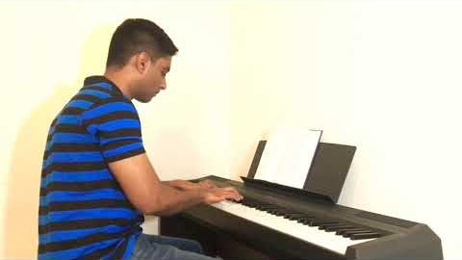
CALLED AS PARTNERS IN CHRIST’S SERVICE
Glory to God #761

Slide 14
PRAYERS OF THE PEOPLE
God, our foundation, you hear the cries of the world and you send each of us out for one another, both steady as a rock and soft with your love. Keep before us the life and way of Jesus, who showed us the way of being in the world, unyielding in demanding justice for all, and gentle with grace and kindness for all who suffered.
When we waver, give us courage.
When we doubt, give us strength.

Slide 15
PRAYERS OF THE PEOPLE
When we refuse, realign us.
When we forget, remind us.
When we ourselves cry out, send your tenderness in another.
When we hear the cries of others, turn us toward them.

Slide 16
PRAYERS OF THE PEOPLE
When we want to hide, draw us out.
When we go out as living stones, nourish us for the next time.
We ask all of these things through Christ, who taught us to pray, saying:

Slide 17
THE LORD’S PRAYER
Our Father, who art in heaven, hallowed be thy name.
Thy kingdom come, thy will be done, on earth as it is in heaven.
Give us this day our daily bread;
and forgive us our debts, as we forgive our debtors;
and lead us not into temptation, but deliver us from evil.
For thine is the kingdom and the power and the glory, forever. Amen.

Slide 18
OFFERING
The cornerstone on which the church is built is Jesus Christ, who offers the true measuring line for all we build in his name. Like him, you are called to be living stones, true and stable, in this congregation and in the community. Your faithful gifts are one way that we can continue to build on the foundation of Jesus Christ. Please consider giving online or by check this week.

Slide 19
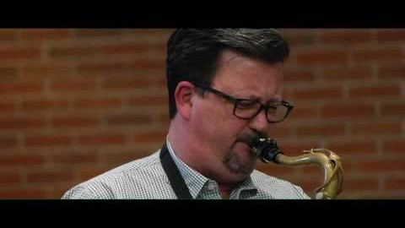
LORD, YOU GIVE THE GREAT COMMISSION
Glory to God #298

Slide 20
CHARGE & BENEDICTION
Over these last six weeks, we have borne the weight of doubt like a millstone and have stumbled along the rocky road to Emmaus. We have built walls to protect us and insulate us, only to learn that God is building a church that does not have walls of rock and mortar, but a church on which Jesus Christ, a living stone, is the foundation.

Slide 21
CHARGE & BENEDICTION
Now then, you must be living stones as well, the church visible in the world through your demonstration of compassion, justice, and praise. In this renewed calling, remember that you are precious in God’s sight.
Let yourselves be the living stones out in the world. You are invited to take the stone you’ve been holding as part of your worship these weeks and place it prominently as a reminder of your call from God.

